Slide 1
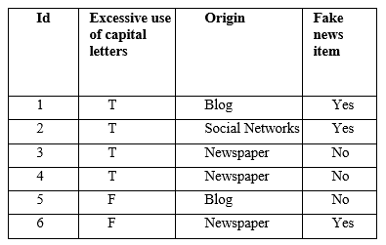
1. Decision trees.
Consider the following data that will be used to train a C4.5 decision tree
The class label is indicated in last column of this table.
Which question would appear at the root of a C4.5 decision tree?
First, perform a numerical encoding of the attributes.
Detail the calculations you needed to perform to determine the optimal split at the root of the tree using Information Gain.

Slide 2
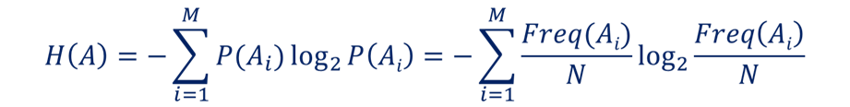
Option 1 with id3.
a) Entropy of a feature:
Entropy(ClassFake) = – p(Yes) * log2p(Yes) – p(No) * log2p(No) =
– (3/6) *log2(3/6) – (3/6) *log2(3/6) = -0.5*(-1) -0.5*(-1) = 1

Slide 3

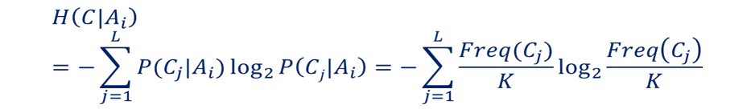
Option 1 with id3.
Conditional Entropy of C|A
Entropy of C conditioned on A
Partition using Capitals
Step 1)
P(CapitalsYes) =4/6=0.66
P(CapitalsNo) = 2/6= 0.33;
Step 2)
Entropy(Class|Capitals=Yes) = – p(No) log₂p(No) – p(Yes) log₂p(Yes) = – (3/3)log₂(3/6) – (3/6)log₂(3/6) = 1
Entropy(Class| Capitals =No) = – (1/2)log₂(1/2) – (1/2)log₂(1/2) = 1
Step 3)
Entropy(Class|Capitals) =0.66*1 + 0.33*1= 1
Step 4) IG(Class|A)= H(C)-H(C|A)
IG(Class|Capitals) = H(Class) - H(Class|Capitals)= 1-1= 0

Slide 4
Option 1 with id3.
Conditional Entropy of C|A
Entropy of C conditioned on A
Partition using Origin
Step 1)
P(Blog) =2/6=0.33
P(Newspaper) = 3/6= 0.5;
P(SN) = 1/6= 0.17;
Step 2)
Entropy(Class| Blog) = – p(No) log₂p(No) – p(Yes) log₂p(Yes) = – (1/2)log₂(1/2) – (1/2)log₂(1/2) = 1
Entropy(Class| Newspaper) = – (2/3)log₂(2/3) – (1/3)log₂(1/3) = -0.67*(- 0.58) -0.33*(-1.6) = 0.389 +0,528= 0,917
Entropy(Class| SN) = – (0/1)log₂(0/1) – (1/1)log₂(1/1) = 0
Step 3)
Entropy(Class|Origin) =0.33*1 + 0.5*0.917 + 0.16*0 = 0,789
Step 4) IG(Class|A)= H(C)-H(C|A)
IG(Class|Origin) = H(Class) - H(Class|Origin)= 1-0,789= 0.21
"Origin " is chosen at the root as it has the maximum gain of information (minimum entropy of the class given the question)

Slide 5
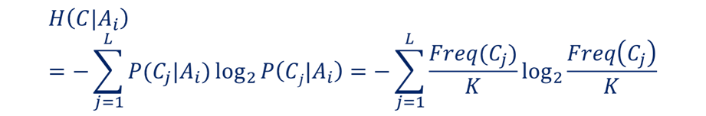
OPTION 2. If we do it as c4.5 and hence pass to binary each categorical variable (one hot encoding) for attribute Capitals is the same But for attribute Origin:
Partition using Blog
Step 1)
P(Blog) =2/6=0.33
P(NoBlog) = 4/6= 0.66;
Step 2)
Entropy(Class| Blog) = – p(No) log₂p(No) – p(Yes) log₂p(Yes) = – (1/2)log₂(1/2) – (1/2)log₂(1/2) = 1
Entropy(Class|NoBlog) = – (2/4)log₂(2/4) – (2/4)log₂(1/2) = 1
Step 3)
Entropy(Class|Blog) =0.33*1 + 0.66*01 = 1
Step 4) IG(Class|A)= H(C)-H(C|A)
IG(Class|Blog) = H(Class) - H(Class|Blog)= 1-1= 0
Partition using Newspaper
Step 1)
P(News) =3/6=0.5
P(NoNews) = 3/6= 0.5;
Step 2)
Entropy(Class| News) = – p(No) log₂p(No) – p(Yes) log₂p(Yes) = – (2/3)log₂(2/3) – (1/3)log₂(1/3) = 0.9183
Entropy(Class|NoNews) = – (1/3)log₂(1/3) – (2/3)log₂(2/3) = 0.9183
Step 3)
Entropy(Class| News) =0.5*0.9183 + 0.5*0.9183 = 0.9183
Step 4) IG(Class|A)= H(C)-H(C|A)
IG(Class| News) = H(Class) - H(Class| News)= 1-0.9183 = 0.0817

Slide 6
OPTION 2. If we do it as c4.5 and hence pass to binary each categorical variable (one hot encoding) for attribute Capitals is the same But for attribute Origin:
Partition using SN
Step 1)
P(SN) =1/6=0.17
P(NoSN) = 5/6= 0.83;
Step 2)
Entropy(Class| SN) = – p(No) log₂p(No) – p(Yes) log₂p(Yes) = – (0/1)log₂(0/1) – (1/1)log₂(1/1) = 0
Entropy(Class|NoSN) = – (3/5)log₂(3/5) – (2/5)log₂(2/5) = 0.9709
Step 3)
Entropy(Class| SN) =0.17*0 + 0.83*0.9709= 0.809
Step 4) IG(Class|A)= H(C)-H(C|A)
IG(Class| SN) = H(Class) - H(Class| SN)= 1-0.809= 0.191
“Blog" is chosen at the root as it has the maximum gain of information (minimum entropy of the class given the question)

Slide 7
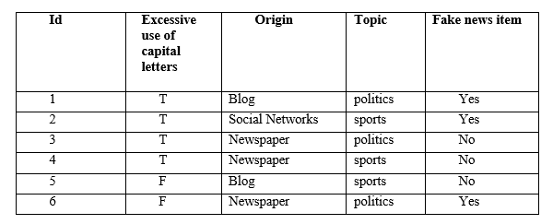
1.b Decision trees.
Consider now the enlarged dataset
If we develop a k-NN model with k=3, what is the model's prediction for a new instance with capitals "T", Origin "Newspaper" and topic "sports"?
To answer this question, encode variables in the way you think is most convenient. Explain your decisions and reasoning.

Slide 8
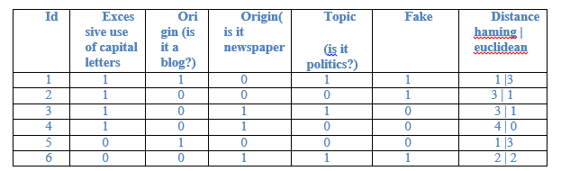
The 3 closest to < capitals ="T", Origin= "Newspaper" and topic= "sports"? > are 2, 3, 4. If we use Hamming distance.
It is normal to choose one hot encoding.
In general, we should take that nominal qualitative variables (non-ordinal variables) transformed into a Boolean variable for each value other than the attribute.
The most appropriate coding could be ->
capitals : F=0, T= 1.
origin: blog Yes=1.
Newspaper Yes=1
(we can assume those two colums to 0 are socialNetworks).
Topic Politics No(sports)=0 politicsYes=1 .
Encoded we look for the three vectors closest to (1,0,1,0). The answers are 1 yes and 2 no’s. Then the model responds no it is not a fake new.

Slide 9
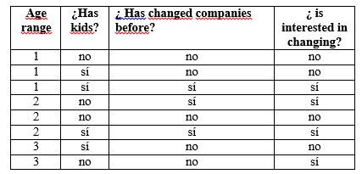
2. Decision trees.
An electricity company is conducting a customer acquisition campaign. To make the campaign as efficient as possible, they will make calls only to customers who are interested in changing companies. To do this, a model will be developed, based on the data obtained in a survey conducted with a subset of clients, that predicts whether a client is interested in changing companies or not:
The prediction system is a decision tree that predicts if a customer is interested in changing companies.
a. What question would put the C4.5 algorithm in the root? Encode variables to numeric first. Detail the calculations you have to perform to correctly answer this question. Note: Consider the Information Gain as a measure.

Slide 10
In total there are 4 “Yes”, 4 “No”, and 8 rows
Entropy(ClassChange) = – p(Yes) * log2p(Yes) – p(No) * log2p(No) =
– (4/8) *log2(4/8) – (4/8) *log2(4/8) = -0.5*(-1) -0.5*(-1) = 1
IG will be 1-H(C|A) so the lowest value of H will be the biggest of IG
Conditional Entropy of C|A
Entropy of C conditioned on A
Kids:
Kids= yes: 2 yes, 2 no.
Kids= no: 2 yes, 2 no.
H(Class | kids) = 4/8 · H(2/4, 2/4) + 4/8 · H(2/4, 2/4) = -0.5*(-1) -0.5*(-1) = 1

Slide 11
In total there are 4 “Yes”, 4 “No”, and 8 rows
Conditional Entropy of C|A
Entropy of C conditioned on A
change:
change = yes: 3 yes, 0 no.
change = no: 1 yes, 4 no.
H(Class | change) = 3/8 · H(3/3, 0/3) + 5/8 · H(4/5, 1/5) = -0.375*(0) -0.625*(--0.72) = 0.45
3/3*log₂3/3 +0*log₂0= 0
4/5*log₂4/5 +1/5*log₂1/5= 0.8*0.32 +0.2*2.32=0,256 +0,464=0,72
We need to compute Age…Next slide
“Change" is chosen at the root as it has the maximum gain of information (minimum entropy of the class given the question)

Slide 12
In total there are 4 “Yes”, 4 “No”, and 8 rows
Conditional Entropy of C|A
Entropy of C conditioned on A
Age >1:
Branch yes : 3 yes , 2 no = 5
Branch no: 1 yes , 2 no =3
H(Class | Age >1) = 5/8·H(3/5,2/5) + 3/8·H(1/3,2/3) = = - 0.625 *(- 0.968) - 0.375 *(-0.924) =0.605 + 0.3465=0.95.
3/5*log₂3/5 +2/5*log₂2/5= 0.6*0.74 +0.4*1.32=0.44 +0.528=0.968
1/3*log₂1/3 +2/3*log₂2/3= 0.33*1.6 +0.66*0.6=0,528 +0,396=0,924
Age >2:
Branch yes :1 yes , 1 no.
Branch no : 3 yes , 3 no.
H(Class | Age >2) = 2/8·H(1/2,1/2) + 6/8·H(3/6,3/6) = -0.5*(-1) -0.5*(-1)= 1.
“Age>1" is chosen as separation criteria as it has the maximum gain of information (minimum entropy of the class given the question)

Slide 13
2. 1. Knn
b. If now the problem is trying to solve using a model based on nearest neighbors. What does your k-NN model predict with k = 3 for the test pattern “age = 2, kids = yes, changed = no”?

Slide 14
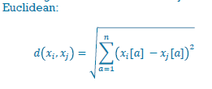
k=3: there are four tied patterns with d2=1. Three are of the “no” class, and one is of the “yes” class. Take the three that are taken, the majority class is "no", so k-NN with k=3 predicts "no".
ID | Age | ¿Kids? | ¿ changed before? | ¿predict change? | d²
1 | 1 | 0 | 0 | no | 2
2 | 1 | 1 | 0 | no | 1
3 | 1 | 1 | 1 | sí | 2
4 | 2 | 0 | 1 | sí | 2
5 | 2 | 0 | 0 | no | 1
6 | 2 | 1 | 1 | sí | 1
7 | 3 | 1 | 0 | no | 1
8 | 3 | 0 | 0 | sí | 2
Test: 2 1 0 ?

Slide 15
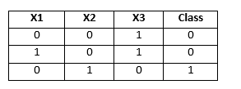
3. Logistic Regression.
Consider the following dataset:
We want to train a logistic regression using this dataset.
All the initial weights are 0.1 and the learning rate is 1. Online training is used.
What is the result after the first epoch?
Write all the steps necessary to perform these calculations.

Slide 16
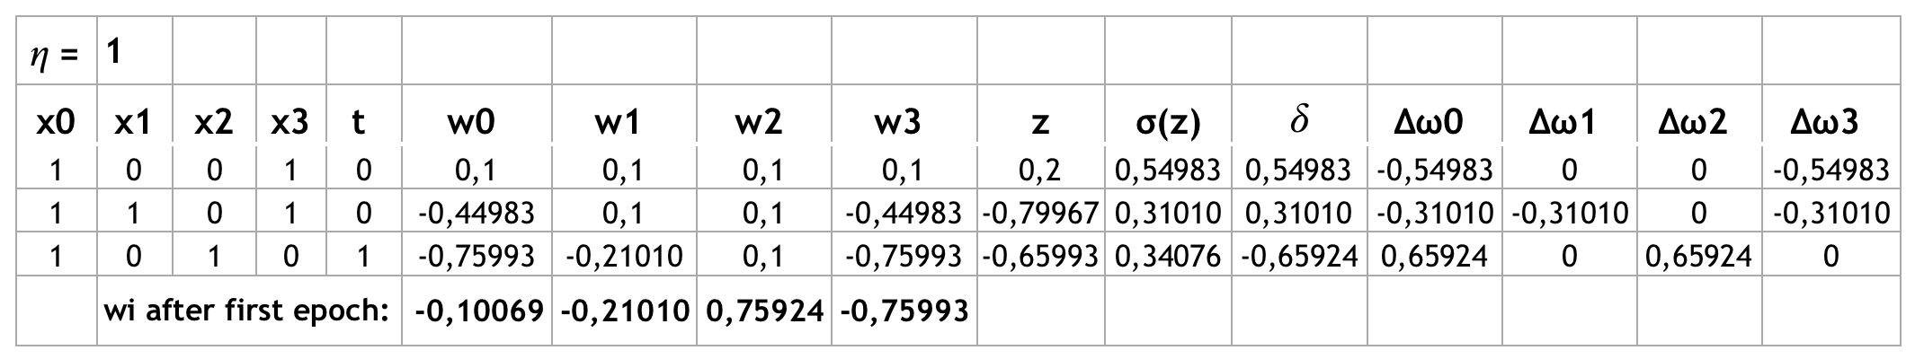
In a logistic regression with 2 classes, the estimated probability of class 1 is:
σ(z) = 1 / [1 + e^(-z)]
with z = 𝐰T𝐱 = w0 + w1·x1 + w2·x2 + w3·x3 (in our case there are 3 attributes)
If the logistic regression is trained using on online training, each weight is updated as:
𝐰_{i}(new) = 𝐰_{i}(old) − 𝜂 𝛿_{𝑛} 𝐱_{i𝑛}
with 𝜂 being the learning rate and 𝛿_{𝑛} = 𝜎(𝐰^{T}𝐱_{𝑛}) − 𝑡_{𝑛} , with n being training example n.
The calculations and weights after the first epoch are:

Slide 17
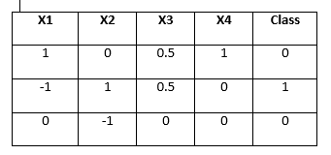
4. Neural networks and logistic regression.
Consider the following dataset:
We want to train a logistic regression using this dataset.
All the initial weights are 1 and the learning rate is 0.5. Batch training is used.
What is the result after the first epoch? Write all the steps necessary to perform these calculations.

Slide 18
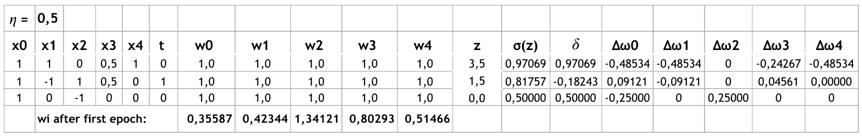

In a logistic regression with 2 classes, the estimated probability of class 1 is:
σ(z) = 1 / [1 + e^(-z)]
with z = 𝐰^{T}𝐱 = w0 + w1·x1 + w2·x2 + w3·x3 + w4·x4 (in our case there are 4 attributes)
If the logistic regression is trained using on online training, each weight is updated as:
𝐰_{i}(new) = 𝐰_{i}(old) − 𝜂 𝛿_{𝑛} 𝐱_{i𝑛}
with 𝜂 being the learning rate and 𝛿_{𝑛} = 𝜎(𝐰^{T}𝐱_{𝑛}) − 𝑡_{𝑛} , with n being training example n.
The calculations and weights after the first epoch are:
1,25

